Slide 1

User Analysis in the Telecommunication Industry
Presented by Isha Rawat

Slide 2

Problem Statement
Determine whether TellCo is a strategic investment opportunity by uncovering data-backed paths for revenue growth and customer value maximization.

Slide 3
•Analyze dataset to understand user behavior, network usage, and service patterns.
•Identify high-potential customer segments and usage trends that could drive profitability.
•Deliver a dashboard and report with actionable insights to guide the acquisition decision.
Objectives

Slide 4
Objective: Identify user behavior patterns through clustering
Dataset: telcom_data.csv
Techniques: Standardization, PCA, KMeans
Project Overview

Slide 5
Observations & Business Implications
Apple is the dominant brand among customers with high handset usage spread across multiple models.
Huawei’s top device (B528S-23A) may indicate significant use of mobile routers or home internet hubs, not smartphones.
Samsung’s presence is broad but less concentrated, with no standout model usage as high as Apple’s or Huawei's top device.

Slide 6
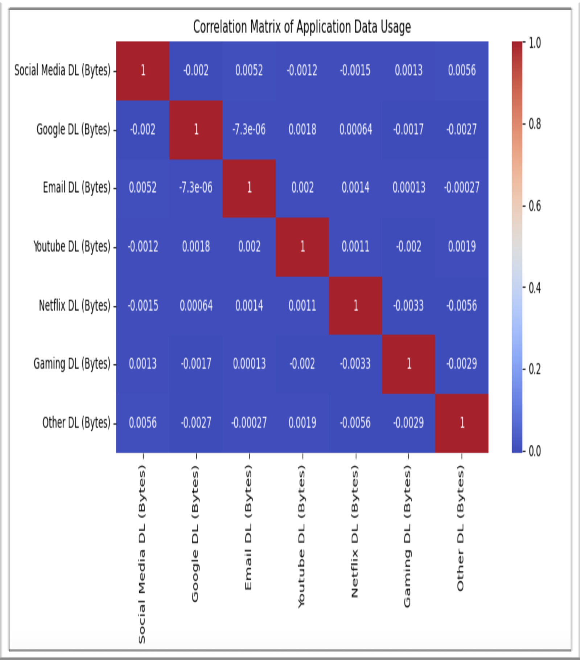
Correlation Matrix of Application Data Usage
Very Low Correlation Across All Categories
Most correlation values are close to zero
This suggests that data usage for different applications is nearly independent of each other
No strong positive or negative correlation exists between any pair of applications

Slide 7
Social Media Downloads show almost zero correlation with all other types (e.g., -0.002 with Google, -0.0012 with YouTube).
YouTube and Netflix DL: Correlation = 0.0011 → Practically no relationship.
Gaming DL vs. Netflix DL: Correlation = -0.0033 → Slightly negative, but statistically insignificant.
Email DL shows tiny positive correlation (0.002) with YouTube and Netflix, again negligible.
Other DL shows slightly higher correlation with Social Media DL (0.0056) than others, but still extremely weak.
Detailed Insights by Category

Slide 8
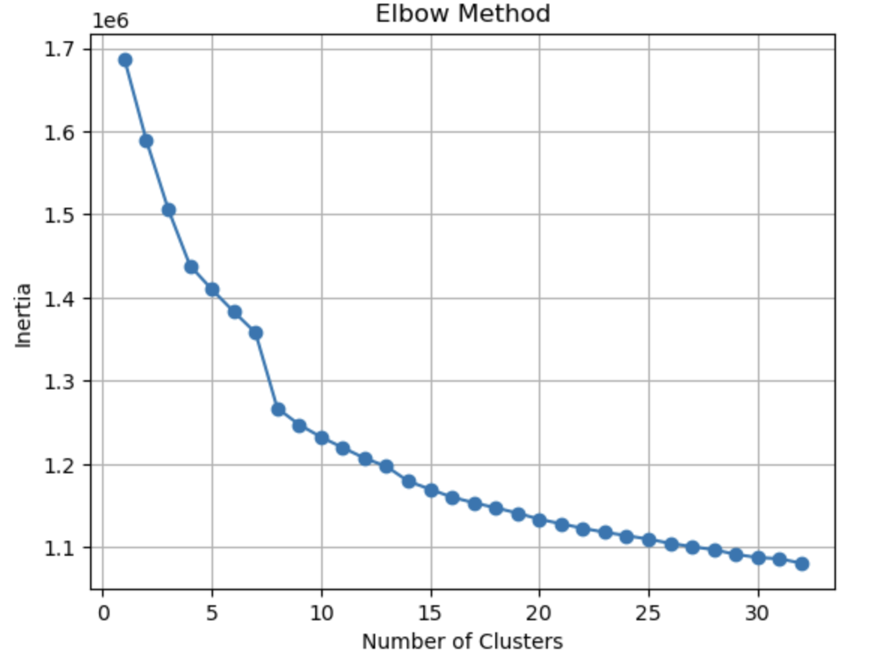
KMeans Clustering using Elbow Method to find optimal number of clusters

Slide 9
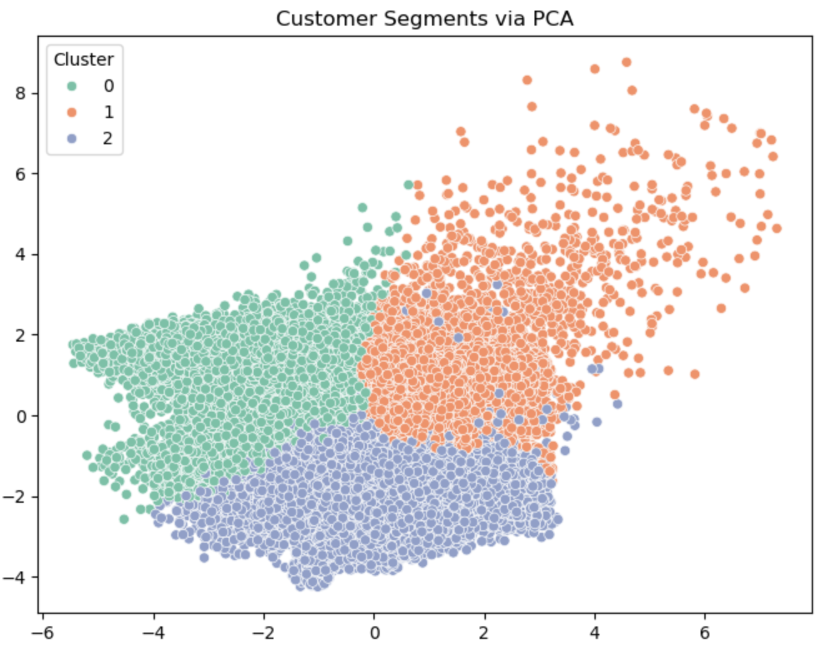
Visualization of cluster distribution with k=3

Slide 10
After practicing multiple PCA(n_components= range 2-30) Clusters are not well-separated.
Many clusters overlap ,which spreads across almost the entire PCA space.This suggests that higher k value, leading to overfitting or poor cluster definition.
Clearer separation between clusters.
Each cluster seems to capture a distinct region in PCA space.
This implies better-defined groupings and likely more interpretable customer segments.
Visually, it supports the idea that 3 clusters is a more optimal choice for this data.
Why Clustering with k = 3

Slide 11
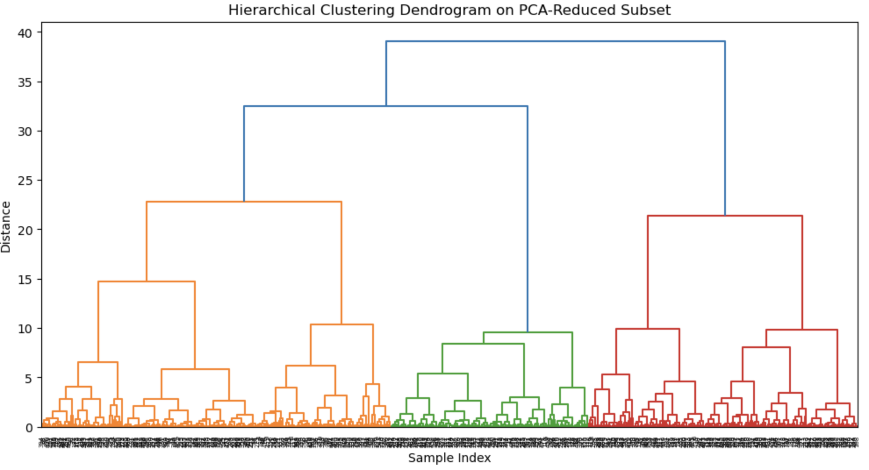
Hierarchical Clustering Dendrogram

Slide 12
Hierarchical Structure: The tree-like structure shows how clusters are progressively merged based on similarity (Euclidean distance in PCA space). Lower joins (near the bottom) indicate closer samples, while higher joins represent merging of larger, less similar groups.
Cluster Compactness : The bottom parts of the tree are denser, meaning many samples are closely related. The larger vertical distances in upper levels indicate some well-separated high-level groupings.
Euclidean Distance

Slide 13
Cluster-Based Segment Insights
Heavy users:
Behavioral Traits:
Consume large amounts of data.
Frequently use high-bandwidth apps like YouTube, Netflix, or Social Media.
Likely use higher-end handsets.
Often engage in long or multiple sessions daily.
Light users:
Behavioral Traits:
Use minimal data.
May use their devices primarily for calls, SMS, or basic browsing.
Often own low- to mid-range handsets.
Less active on streaming or social platforms

Slide 14
Cluster-Based Marketing Strategy
Heavy users:
Offer Unlimited or High-Cap Data Plans as these users more likely to pay for plans that don’t restrict their usage. Like, Unlimited streaming packages,Weekend/night data boosts.
Free YouTube access at certain times.
Partnered video platform subscriptions.
Loyalty/Retention Benefits like,Reward heavy users with early access to new features or loyalty perks
Consider bundling content (e.g., YouTube Premium, Netflix) into plans.
Light users:
Promote Entry-Level or Budget Plans, like Limited data + talktime combo, Flexible top-up plans (pay-as-you-go).
Encourage Device Upgrades: by Offering discounted smartphones or routers to increase engagement.
Educate users on how newer devices can unlock better performance or app usage
Introduce small, trial app packages (e.g., 500MB for YouTube) to drive gradual data use.
Offer device insurance or basic tech support as add-ons.

Slide 15
Thank You.

